Slide 1
Accurate SoC Estimation of Lithium Ion Battery
By
Sanjog Awasthi (21BEI0063)
Adit Tiwari (21BEI0121)
Aman Singh (21BEI0126)
Guide:
Dr. M.Geetha
Professor Grade -1
SELECT

Slide 2
Contents
Introduction
Problem Definition
Literature Survey
Objectives
Hardware Components
Sequence of Operation
Programming
Graphical Design
Results
Conclusion
References

Slide 3
Introduction
The use of lithium-ion batteries is growing fast in electric vehicles, solar energy systems, and portable devices like phones and laptops.
To ensure their safe and efficient use, we need smart Battery Management Systems (BMS).
One of the most important features of a BMS is estimating the State of Charge (SoC) — it tells us how much battery power is left.
Accurate SoC estimation helps:
Prevent battery damage (from overcharging or deep discharge)
Improve energy use in power-limited devices
Extend battery life and reduce electronic waste
Traditional methods like using just voltage are not reliable due to battery behavior changes with load, temperature, and age.

Slide 4
Problem Definition
As batteries are widely used in EVs, solar systems, gadgets, and medical devices, accurate SoC (State of Charge) estimation is crucial for safety and performance.
Current challenges in SoC estimation:
Voltage-based method is simple but becomes inaccurate under load due to voltage drops.
Coulomb counting is real-time but can drift over time and needs regular calibration.
Lack of IoT in many systems means no remote monitoring or alerts, reducing safety and reliability.
There’s a need for a smart, low-cost, and accurate SoC estimation system that:
Uses multiple methods to improve reliability
Runs on affordable microcontrollers like Arduino/ESP32
Supports IoT-based monitoring through smartphones or the cloud

Slide 5
Literature Survey
Piller, S., Perrin, M., & Jossen, A. “Methods for state-of-charge determination
and their applications.” Journal of Power Sources, 96(1), 113–120, 2001.
Key Insights:
Estimates SoC based on terminal voltage mapped to an SoC-voltage curve.
Simple, low-cost, and easy to implement on microcontrollers.
Performance degrades under dynamic loads due to voltage drops.
Highly sensitive to temperature, cell aging, and internal resistance.
Limitations:
Accurate only under no-load or stable conditions.
Poor standalone reliability under real-world usage.

Slide 6
Literature Survey
Kim, I.S. “The novel state of charge estimation method for lithium battery
using sliding mode observer.” Journal of Power Sources, 163(1), 584–590,
2006.
Key Insights:
Integrates current flow over time to calculate net charge (in/out of battery).
Suitable for real-time estimation.
Commonly used in embedded battery systems.
Limitations:
Long-term drift due to sensor inaccuracies, noise, and offset errors.
Needs periodic calibration or correction via hybrid methods.

Slide 7
Literature Survey
He, H., Xiong, R., & Fan, J. “Evaluation of Lithium-Ion Battery Equivalent
Circuit Models for State of Charge Estimation by an Experimental Approach.”
Energies, 4(4), 582–598, 2011.
Key Insights:
Uses model-based recursive estimation combining voltage/current with system dynamics.
Dynamically corrects SoC with high robustness to noise and non-linearity.
Performs well under fluctuating loads and environmental variability.
Limitations:
More computationally intensive.
Requires precise modeling of battery behavior.

Slide 8
Literature Survey
Noh, C., Park, K., & Choi, J. “Development of Battery Monitoring System
Using IoT Technology.” Proceedings of the 2017 International Conference on
Information and Communication Technology Convergence (ICTC).
Key Insights:
IoT-based SoC systems enable remote monitoring, alerts, and real-time tracking.
Enhances user interaction and system diagnostics via smartphones/web.
Supports data logging and cloud-based analytics.
Limitations:
Hybrid SoC estimation via IoT still under-researched.
Scalability and affordability remain challenges for small applications.

Slide 9
Objectives
Develop a real-time SoC estimation system for lithium-ion batteries.
Implement hybrid estimation using Direct Voltage, Coulomb Counting, and Kalman Filter methods.
Improve SoC accuracy under dynamic conditions and fluctuating loads.
Ensure low-cost, low-power design using affordable microcontrollers and sensors.
Create a scalable and deployable solution for research and small-scale applications.

Slide 10
Hardware Components
Arduino Uno: Central microcontroller for data processing and wireless transmission.
ACS712: Current sensor module for Coulomb counting.
Voltage sensor: Measures battery voltage for direct SoC estimation.
16x2 LCD Display: Displays live SoC values and system status.
Li-ion Battery (3.7V/18650): Target cell for SoC monitoring.
Resistors, Breadboard, Wires: For circuit construction and interfacing.
USB Power Supply: Powers the system during testing and deployment.

Slide 11
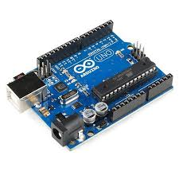
Arduino Uno
Role: Main controller and processor.
Function:
Reads analog voltage and current data from sensors.
Calculates State of Charge (SoC) using voltage-based, Coulomb Counting, and Kalman filter methods.
Displays the results on an LCD and sends data to the serial monitor.

Slide 12
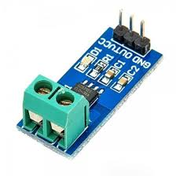
ACS712
Role: Measures the current drawn by or supplied to the battery.
Function:
Outputs an analog voltage proportional to the current.
The zero-current output is 2.5V; deviation from this indicates current direction and magnitude.
Arduino reads this voltage, subtracts the 2.5V offset, and converts it to current using sensitivity (e.g., 185 mV/A for ACS712-5A).

Slide 13
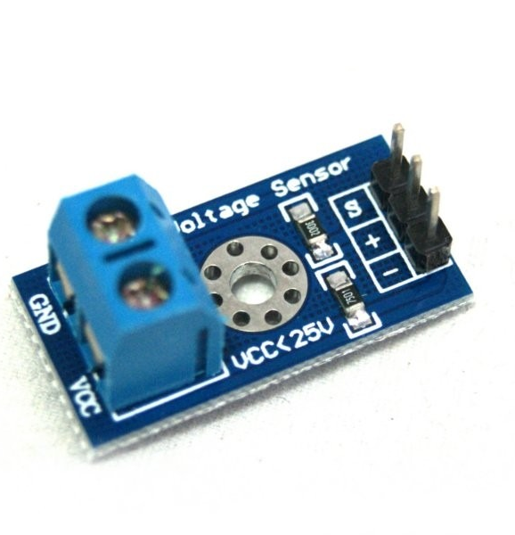
MH25V
Role: Power source under test.
Function:
Its real-time voltage and current are continuously monitored.
SoC is calculated based on its capacity (e.g., 2.2Ah), voltage range (e.g., 3.0V–3.65V), and discharge behavior.

Slide 14
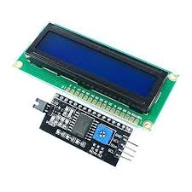
LCD with I2C Module
Role: Displays battery status in real time.
Function:
Shows voltage (V), current (A), and SoC (%) in a user-friendly format.
Uses I2C interface (only two pins: SDA and SCL), leaving more pins free on the Arduino.

Slide 15
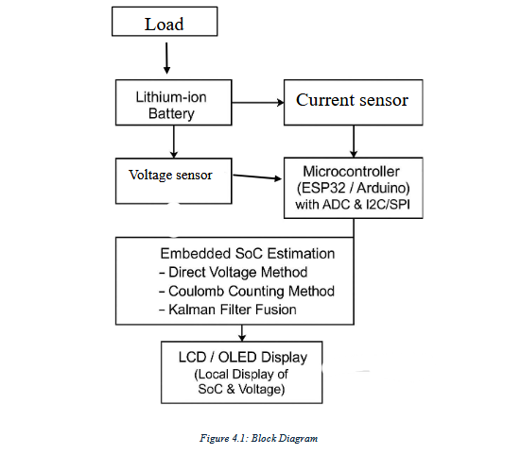
Sequence of Operation

Slide 16
Battery Monitoring
The system begins by monitoring the Li-ion battery (3.7V/18650) connected to the circuit.
Voltage Measurement
The voltage divider circuit measures the open-circuit voltage of the battery.
The voltage value is converted to State of Charge (SoC) using a calibrated lookup table or polynomial regression, primarily for rest periods or low-current load states.
Current Measurement (Coulomb Counting)
The ACS712 current sensor is used to measure the current flowing in or out of the battery.
The system performs Coulomb counting, integrating the current over time to calculate the SoC.
Kalman Filter Integration
The Kalman filter is applied to predict and update the SoC using real-time data.
It minimizes errors, suppresses noise, and provides accurate and stable SoC estimation, especially under rapidly changing conditions.
Display and Feedback
16x2 LCD display shows the live SoC values and system status.
The user can monitor the battery's current charge level and performance through the display.

Slide 17
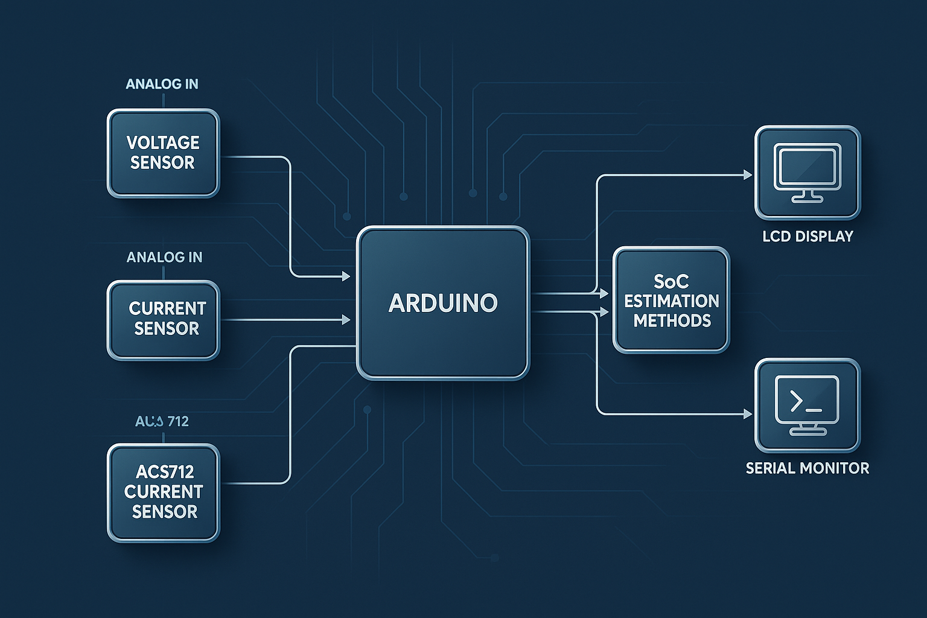
Programming
Inputs: Reads battery voltage and current using analog pins.
Processing: Converts readings, removes noise, and assumes discharge current.
SoC Estimation: Uses three methods — voltage-based, coulomb counting, and Kalman filter.
Output: Displays voltage, current, and SoC on LCD and serial monitor.
Purpose: Estimates battery State of Charge (SoC) accurately using IoT sensors.

Slide 18
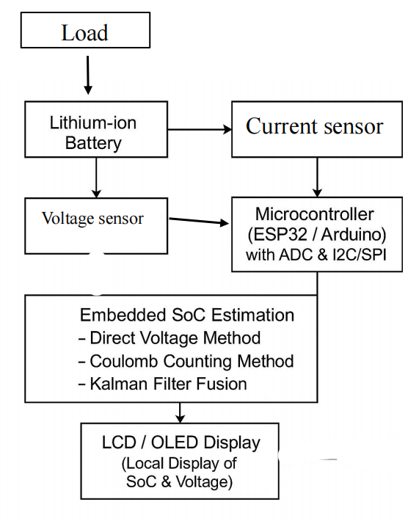
Design Approach

Slide 19

🔋 Lithium-ion Battery Powers the Load
The system begins with a battery supplying current to a connected load.
Its real-time condition is the primary focus of monitoring.
🔍 Sensing Modules
Voltage Sensor (via voltage divider):
Measures battery voltage and feeds it to the microcontroller.
Current Sensor (e.g., ACS712):
Measures the current flow (typically discharge current) from the battery.
🧠 Microcontroller (Arduino)
Reads analog values using built-in ADC.
Communicates with the display through I2C/SPI.
Performs embedded SoC estimation using:
Voltage Method – Estimates SoC from voltage level.
Coulomb Counting – Tracks charge consumed over time.
Kalman Filter – Fuses both methods for improved accuracy.
📊 Display (LCD)
Shows:
Real-time battery voltage
Current
Estimated SoC (%)
Enables easy local monitoring without needing external interfaces.

Slide 20
Results
.
Voltage-based Method:
Simple and quick but suffers from voltage sag under load.
Accurate when the battery is idle but inaccurate during active charge/discharge.
Coulomb Counting Method:
Provides real-time SoC tracking with accurate short-term estimations.
Prone to cumulative errors and drift over time; requires periodic resets.
Kalman Filter Method:
Fuses voltage-based and Coulomb counting methods for improved accuracy.
Minimizes drift, offset errors, and improves stability under varying loads.
Optimal Kalman gain range: 0.4–0.6 for balancing responsiveness and noise suppression.
IoT Integration:
Enabled real-time monitoring with smooth data transmission and mobile notifications.
Overall Outcome:
The hybrid approach (Kalman filter + IoT) provides a balanced, scalable solution for real-time battery monitoring.

Slide 21
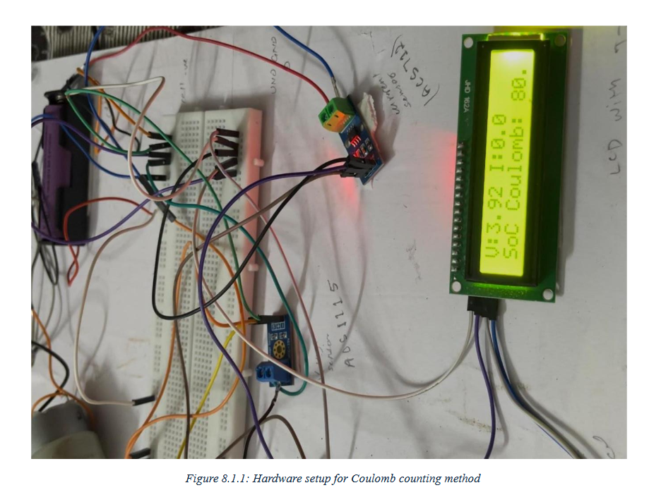
The LCD displays a battery voltage of 3.92V, current of 0.0A, and a State of Charge (SoC) of 90%, indicating that the battery is nearly full and not currently discharging.

Slide 22

The LCD shows a battery voltage of 3.98V, current of 0.0A, and a Kalman Filter-based SoC of 92.1%, indicating a well-charged battery with refined estimation accuracy using sensor fusion.

Slide 23
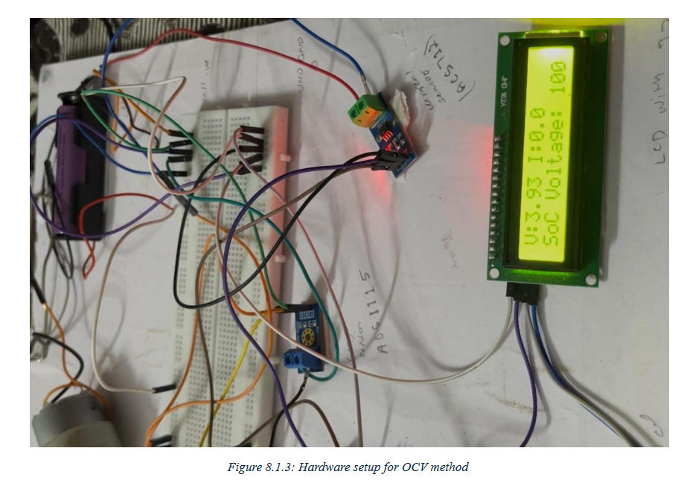
The LCD displays a battery voltage of 3.93V, current of 0.0A, and a State of Charge (SoC) of 100% based on the Open Circuit Voltage (OCV) method, indicating a fully charged battery when at rest.

Slide 24

MATLAB Simulation Output
Compares actual vs. predicted values using an LSTM (Long Short-Term Memory) network.
The close alignment between the blue (actual) and red (predicted) curves confirms the model’s high accuracy in forecasting battery SoC trends.

Slide 25


Slide 26
Conclusion
System Development:
Successful development of a real-time embedded system for battery SoC estimation.
Estimation Techniques:
Integrated voltage-based, Coulomb counting, and Kalman filter methods.
Voltage-based: Fast but limited to open-circuit conditions.
Coulomb counting: Real-time tracking but prone to drift.
Kalman filter: High accuracy and stability under dynamic conditions.
Performance:
Achieved SoC estimation accuracy within ±2–3%.
Usability:
SoC displayed on local LCD and cloud-connected IoT dashboard for real-time monitoring.

Slide 27
References
S. Piller, M. Perrin, and A. Jossen, "Methods for state-of-charge determination and their applications," Journal of Power Sources, vol. 96, no. 1, pp. 113–120, 2001.
G. L. Plett, "Extended Kalman Filtering for Battery Management Systems of LiPB-Based HEV Battery Packs: Part 1. Background," Journal of Power Sources, vol. 134, no. 2, pp. 252–261, 2004.
C. Zhang, K. Li, J. Deng, and J. Gong, "A novel approach for estimating the state of charge of lithium-ion batteries based on a hybrid model," Applied Energy, vol. 105, pp. 142–151, 2013.
S. M. Noh et al., “An IoT-based smart battery monitoring system,” in IEEE Sensors Journal, vol. 17, no. 17, pp. 5617–5625, 2017.
A. Hannan, M. Lipu, A. Hussain, and A. Mohamed, “A review of lithium-ion battery state of charge estimation and management system in electric vehicle applications: Challenges and recommendations,” Renewable and Sustainable Energy Reviews, vol.78, pp. 834–854, 2017.
Blynk Inc., “IoT App Builder Platform,” [Online]. Available: https://www.blynk.io
MathWorks, “Battery State of Charge Estimation,” [Online]. Available:
https://www.mathworks.com

